Slide 1
Polynomial Regression

Slide 2
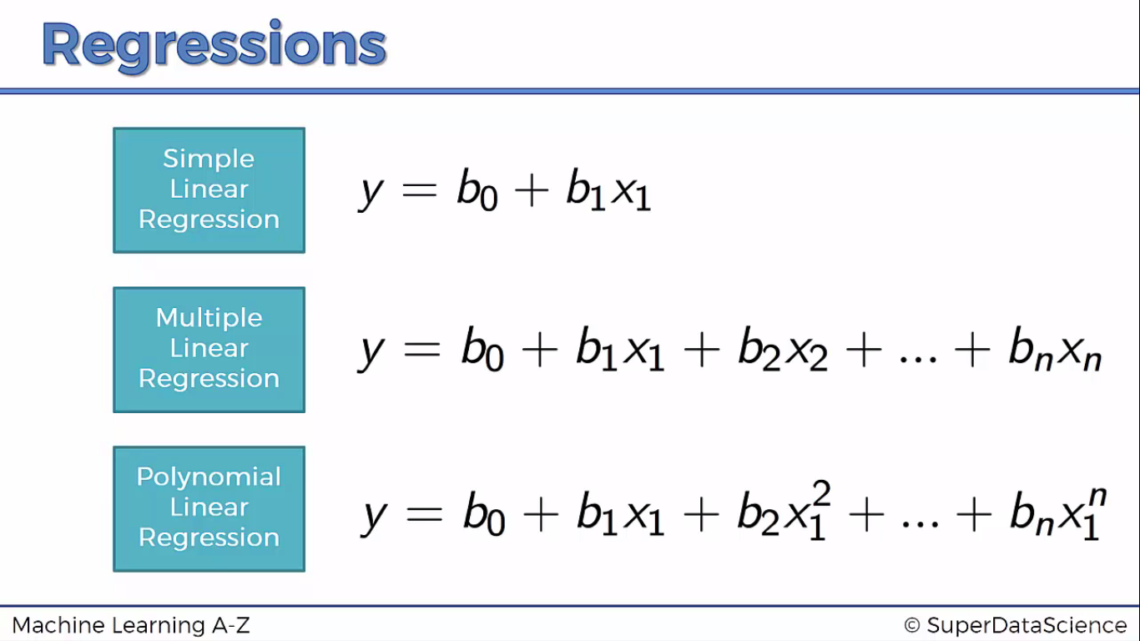

Slide 3
Python

Slide 4
Importing the libraries
import numpy as np
import matplotlib.pyplot as plt
import pandas as pd

Slide 5
Importing the dataset
dataset = pd.read_csv('Position_Salaries.csv')
X = dataset.iloc[:, 1:2].values
y = dataset.iloc[:, 2].values
NOTE : X = dataset.iloc[:, 1:2].values can be rewritten as X = dataset.iloc[: , 1].values
(see whats the problem)

Slide 6
Fitting Linear Regression to the dataset
from sklearn.linear_model import LinearRegression
lin_reg = LinearRegression()
lin_reg.fit(X, y)

Slide 7
Fitting Polynomial Regression to the dataset
from sklearn.preprocessing import PolynomialFeatures
poly_reg = PolynomialFeatures(degree = 4)
X_poly = poly_reg.fit_transform(X)
poly_reg.fit(X_poly, y)
lin_reg_2 = LinearRegression()
lin_reg_2.fit(X_poly, y)

Slide 8
Visualising the Linear Regression results
plt.scatter(X, y, color = 'red')
plt.plot(X, lin_reg.predict(X), color = 'blue')
plt.title('Truth or Bluff (Linear Regression)')
plt.xlabel('Position level')
plt.ylabel('Salary')
plt.show()

Slide 9
Visualizing the Polynomial Regression results
plt.scatter(X, y, color = 'red')
plt.plot(X, lin_reg_2.predict(poly_reg.fit_transform(X)), color = 'blue')
plt.title('Truth or Bluff (Polynomial Regression)')
plt.xlabel('Position level')
plt.ylabel('Salary')
plt.show()

Slide 10
Visualizing the Polynomial Regression results (for higher resolution and smoother curve)
X_grid = np.arange(min(X), max(X), 0.1)
X_grid = X_grid.reshape((len(X_grid), 1))
plt.scatter(X, y, color = 'red')
plt.plot(X_grid, lin_reg_2.predict(poly_reg.fit_transform(X_grid)), color = 'blue')
plt.title('Truth or Bluff (Polynomial Regression)')
plt.xlabel('Position level')
plt.ylabel('Salary')
plt.show()

Slide 11
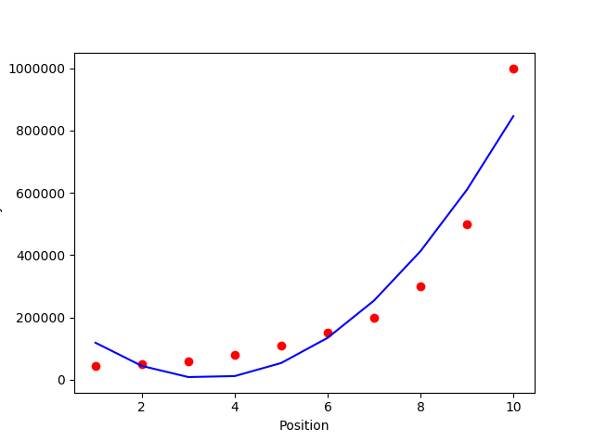

Slide 12
Predicting a new result with Linear Regression
lin_reg.predict(6.5)

Slide 13
Predicting a new result with Polynomial Regression
lin_reg_2.predict(poly_reg.fit_transform(6.5))

Slide 14
R

Slide 15
Read Dataset
library(readr)
dataset <- read_csv("D:/machine learning AZ/Machine Learning A-Z Template Folder/Part 2 - Regression/Section 6 - Polynomial Regression/Polynomial_Regression/Position_Salaries.csv")
dataset = dataset[2:3]

Slide 16
Fitting Linear Regression to the dataset
lin_reg = lm(formula = Salary ~ .,
data = dataset)

Slide 17
Fitting Polynomial Regression to the dataset
dataset$Level2 = dataset$Level^2
dataset$Level3 = dataset$Level^3
dataset$Level4 = dataset$Level^4
poly_reg = lm(formula = Salary ~ .,
data = dataset)

Slide 18
Visualising the Linear Regression results
# install.packages('ggplot2')
library(ggplot2)
ggplot() +
geom_point(aes(x = dataset$Level, y = dataset$Salary),
colour = 'red') +
geom_line(aes(x = dataset$Level, y = predict(lin_reg, newdata = dataset)),
colour = 'blue') +
ggtitle('Truth or Bluff (Linear Regression)') +
xlab('Level') +
ylab('Salary')

Slide 19
Visualizing the Polynomial Regression results
# install.packages('ggplot2')
library(ggplot2)
ggplot() +
geom_point(aes(x = dataset$Level, y = dataset$Salary),
colour = 'red') +
geom_line(aes(x = dataset$Level, y = predict(poly_reg, newdata = dataset)),
colour = 'blue') +
ggtitle('Truth or Bluff (Polynomial Regression)') +
xlab('Level') +
ylab('Salary')

Slide 20
Smoother Curve
# install.packages('ggplot2')
library(ggplot2)
x_grid = seq(min(dataset$Level), max(dataset$Level), 0.1)
ggplot() +
geom_point(aes(x = dataset$Level, y = dataset$Salary),
colour = 'red') +
geom_line(aes(x = x_grid, y = predict(poly_reg,
newdata = data.frame(Level = x_grid,
Level2 = x_grid^2,
Level3 = x_grid^3,
Level4 = x_grid^4))),
colour = 'blue') +
ggtitle('Truth or Bluff (Polynomial Regression)') +
xlab('Level') +
ylab('Salary')

Slide 21
Predictions
# Predicting a new result with Linear Regression
predict(lin_reg, data.frame(Level = 6.5))
# Predicting a new result with Polynomial Regression
predict(poly_reg, data.frame(Level = 6.5,
Level2 = 6.5^2,
Level3 = 6.5^3,
Level4 = 6.5^4))

